Slide 1

MODAF meets its Waterloo
Keith Hasteley
Enterprise Architect, ISS Design
Integrated EA, 4 March 2015

Slide 2

NAF Roadmap
DNDAF
NAF 3.0
NAF 3.1
NAF 4.0
NAF 3.1 + MODAF 1.2.004
2013
using national funding
UAF
DODAF V2

Slide 3
Why MODAF and NATO Architecture Framework (NAF) Convergence is Important
Support alliance interoperability
  enable us to ensure “coherence of architectures”
Methodology
  a core methodology based on best practice (TOGAF)
Re-Use
  Easier identification of NATO systems and applications
Step towards a Unified Architecture Framework
Pooling of limited technical resources
How do we measure a piece of string?
Notes:
To support alliance interoperability by providing a consistent way of describing fielded national capabilities:
Currently MODAF and NAF are similar, but not fully aligned
Convergence would better enable us to ensure “coherence of architectures”
MODAF is a description framework – it does not have it’s own methodology
NAF version 4.0 will have a core methodology based on best practice (TOGAF)
Enabling re-use:
Easier identification of NATO systems and applications that can fulfil MOD Requirements
First Step towards a Unified Architecture Framework that will ultimately include US DoDAF and Canadian DNDAF
Pooling of limited technical resources for framework development
Until now, it has been a “Long Game of Leapfrog”

Slide 4
NAFv4 Draft STANAG
Part of the NATO Architecture CaT programme of work
Chapters 1,3,4 ready for comment by nations
IST 130 working group developing chapter 2 (Methodology)

Slide 5
Current Status - Architecture Capability Team work
TOGAF recommended for use in the design process.
Development of NAF v.4 as a STANAG is the major activity
Completed
ON Going
Notes:
NAF v.4 is the major activity, led by UK in close collaboration with SWE for the Meta-Model and Viewpoints. FRA lead for the chapter 2 Methodology.
UK is finalizing a draft document for STANAG approval of NAF v.4 by 3QR15

Slide 6
Development Strategy
UK to migrate from MODAF to NAF at the earliest opportunity
Develop new draft meta model for NAF based on MODEM and additions offered by other Nations
Develop Draft STANAG
Resolve some historical issues with the view structure (Grid Approach)

Slide 7
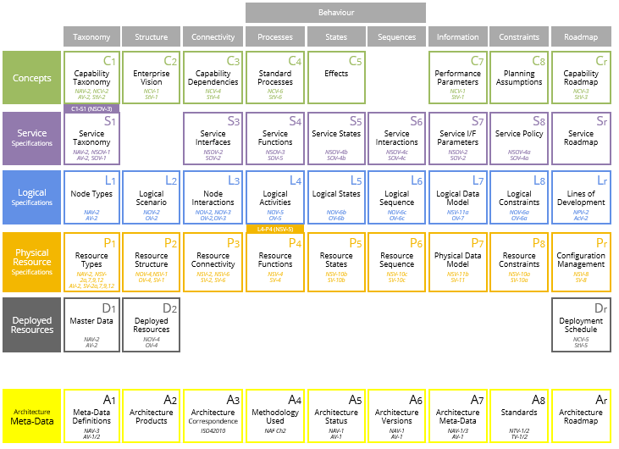
Completed

Slide 8

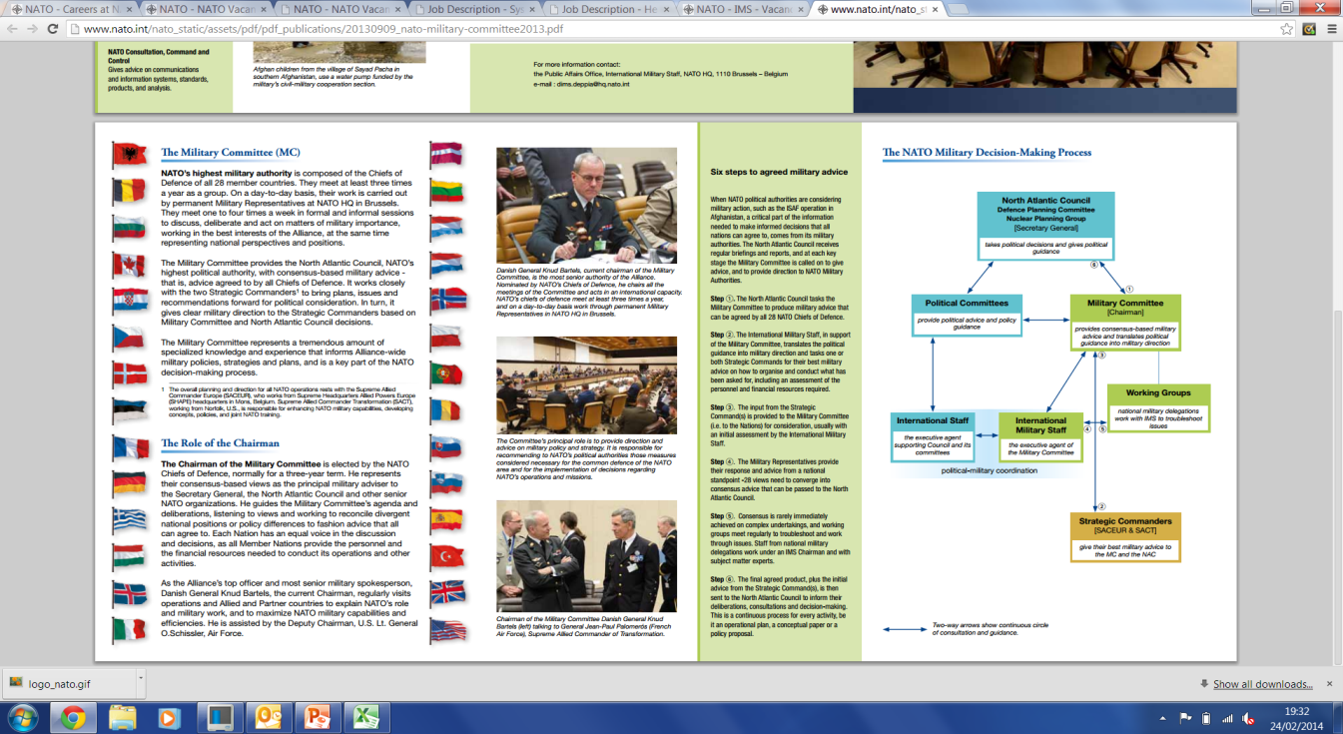

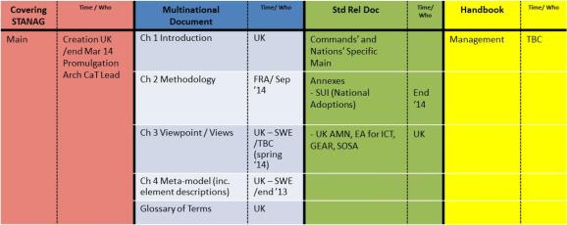
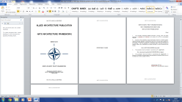
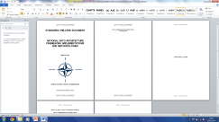
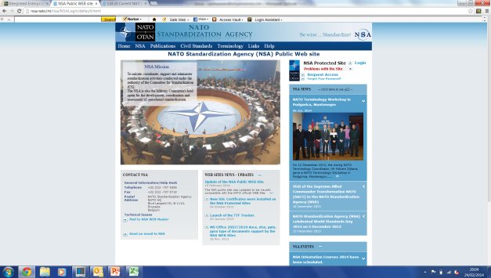


It will take time …
via
Ratified
STANDARDS
C3B
STANAG
A Arch P
SRD
ON Going
NATO IST130
RATIFICATION DRAFTS

Slide 9
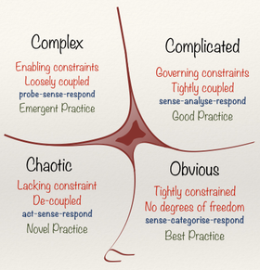
Simple and complex
Understanding
How to apply
meta model
Re-writing the
meta model
Implementation
ISO
Training
Re-arranging
NAF/MODAF
documentation
Notes:
NAF Issues and Opportunities
ISO
Training
DNDAF / DODAF
LFE
Publication
Configuration Management
Implementation

Slide 10


?

